Slide 1

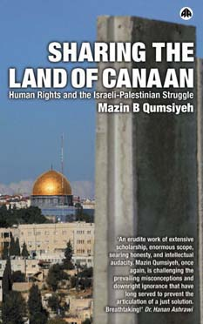


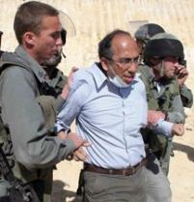
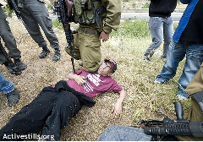

The Science of Sustainability
Prof. Mazin Qumsiyeh
Previously at Duke and Yale University, now Bethlehem University.
Founded a number of laboratories and organizations on human rights
Palestine Museum of Natural History, founded in 2014
Clinical and Research Cytogenetics Laboratory, founded in 2009
http://www.palestinenature.org
Notes:
Test note 1

Slide 2
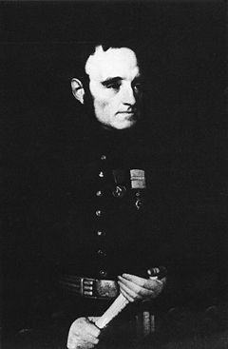
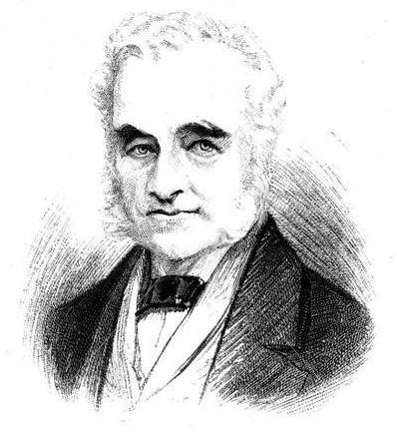
"Tranquilization of Syria and the East: Observations and Practical Suggestions, in Furtherance of the Establishment of Jewish Colonies in Palestine, the Most Sober and Sensible Remedy for the Miseries of Asiatic Turkey.” 1845 report by Lieutenant Colonel George Gawler (1796-1869).
1852 government funding procured for project followed by the Palestine Exploration Fund

Slide 3
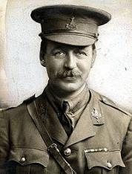
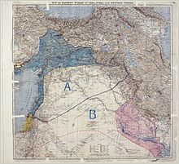
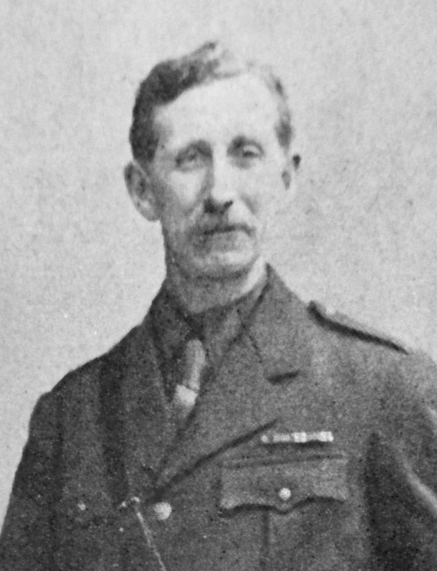


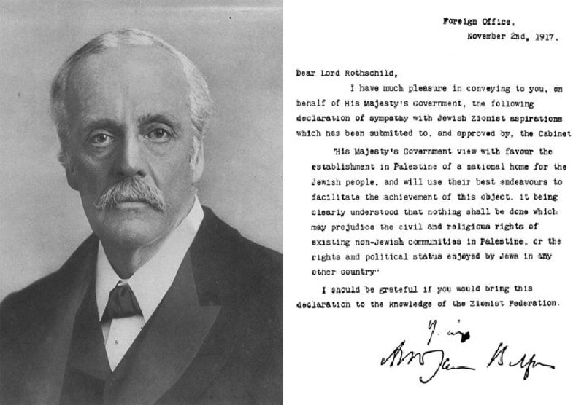
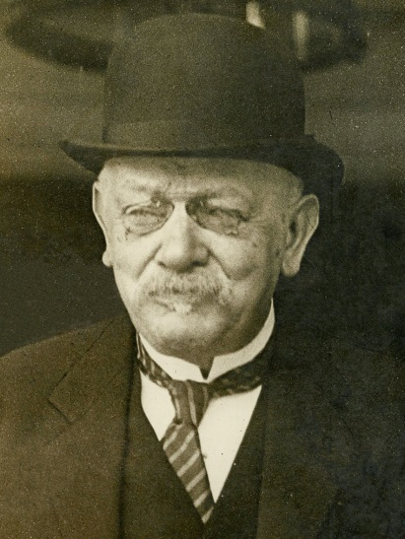
Sir Mark Sykes
1916
Georges-Picot
Arthur James Balfour
1917
Jules Martin Cambon

Slide 4
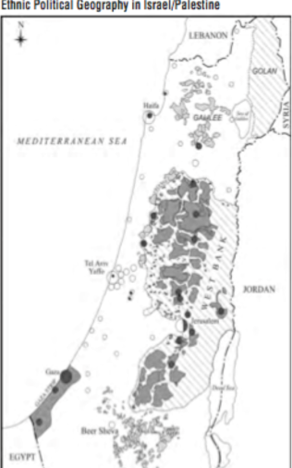
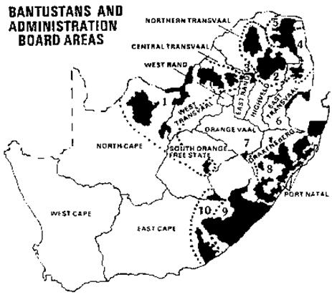
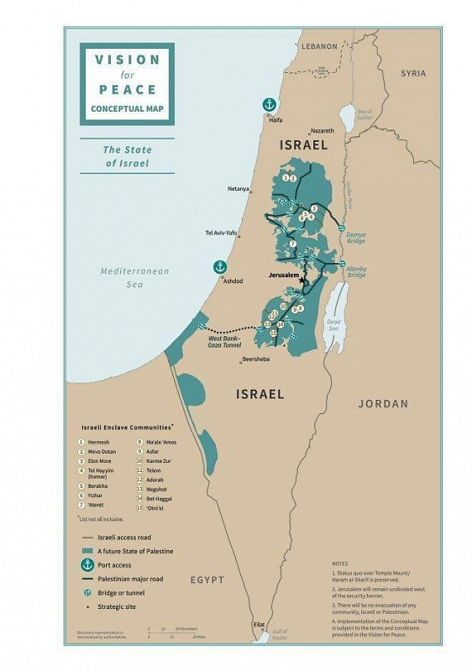
Colonization ongoing for over 100 years:
Currently Palestinians now restricted to
8.3% of the land in an Apartheid System
Qumsiayeh.org

Slide 5
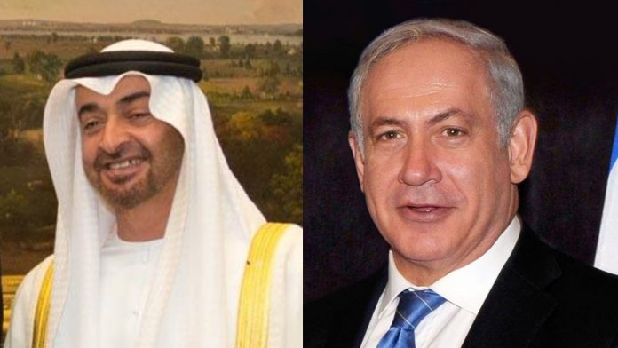


Slide 6
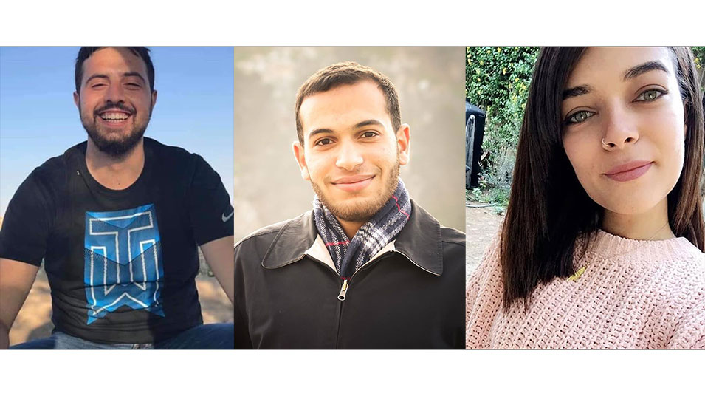
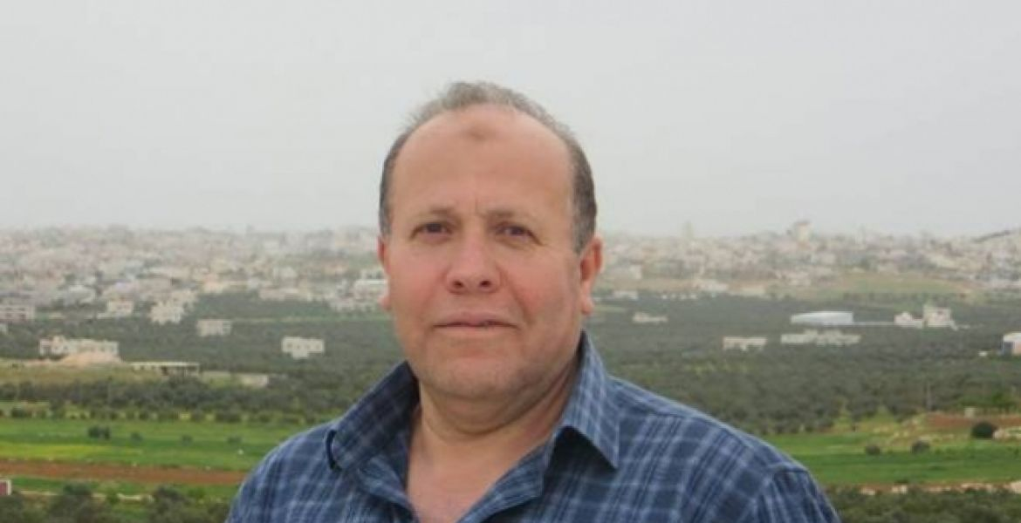

Slide 7
Human rights vs colonization: Take Universal Declaration of Human Rights
Article 1: Equality in dignity and rights
A2: All entitled to protection regardless of background
A3: Right to life liberty and security
A4: No one to be held in slavery or servitude
A5: No torture or mistreatment
A6-11: Equality under the law, fairness etc
A12: Privacy
A13: Freedom of movement, able to leave and return to one’s country

Slide 8
contd
A14: Asylum seekers
A15: Right to Nationality
A16: Family right
A17: Property rights
A18: Freedom of thought and conscience etc
A19: Right to protest
A20: To be part of the government
A21&22: Citizenship rights, Social security and to make associations locally and internationally
A23: Right to work and equal pay etc
A26: Right to education
A27: Cultural rights

Slide 9
Mental Colonization vs Humanization
Dehumanization
Taking away essence of humanity
→ Seen as objects
Humanization
Liberation, authentic existence
→ Seen as subjects
“The greatest weapon in the hand of the oppressor is the mind of the oppressed.”
Stephen Biko
“Free your mind and your ass will follow”

Slide 10
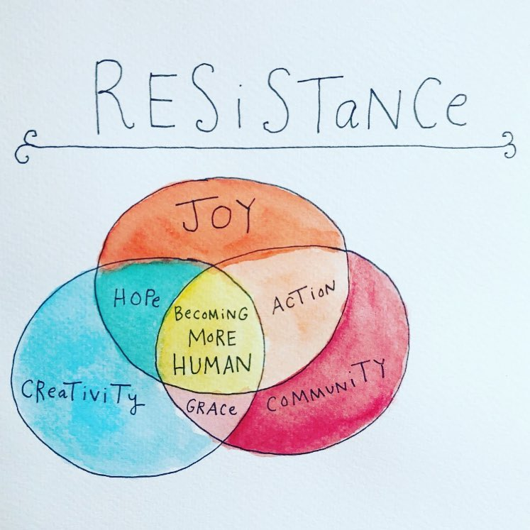
Vision: sustainable human and natural communities
Mission: Research, Education, Conservation
Motto: Respect For ourselves, for others, and for nature
    Impact Orientated
Notes:
PIBS/PMNH vision and mission

Slide 11
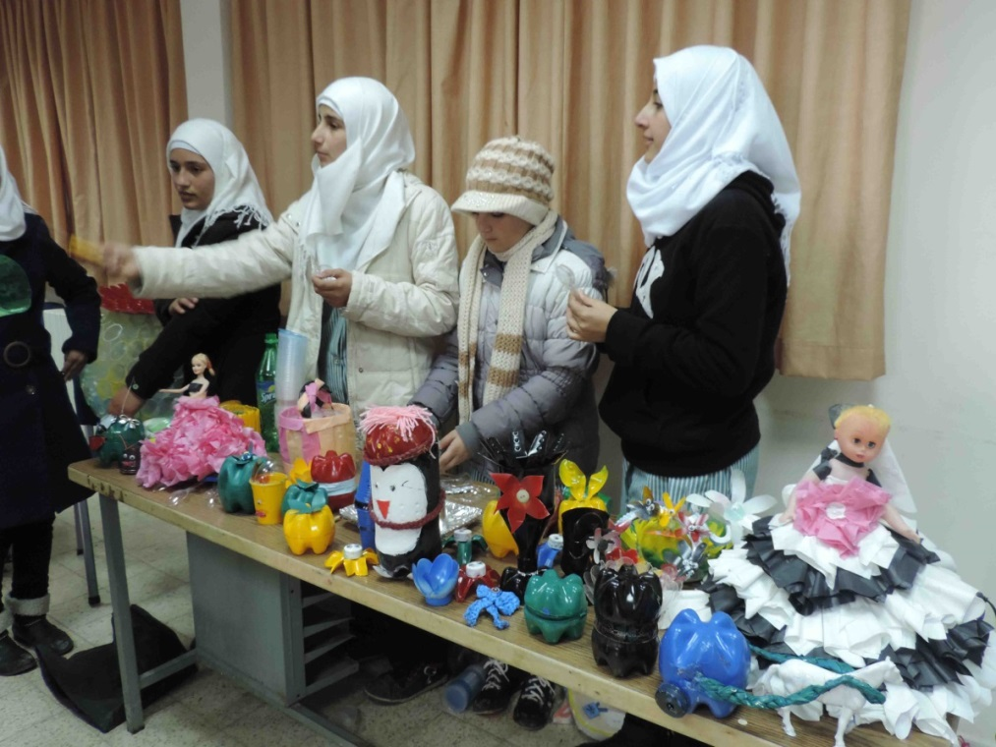
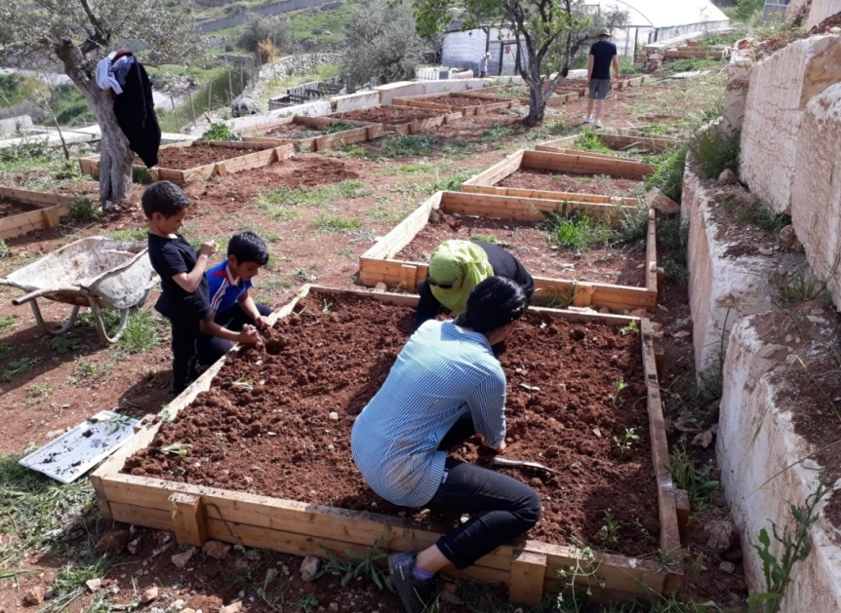
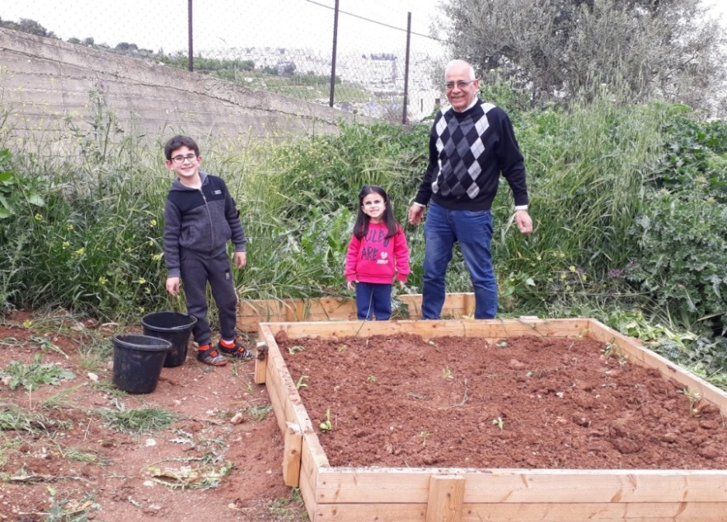
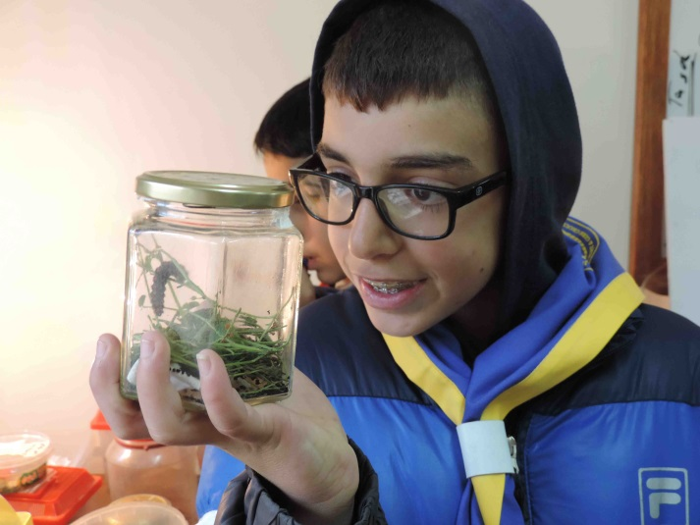
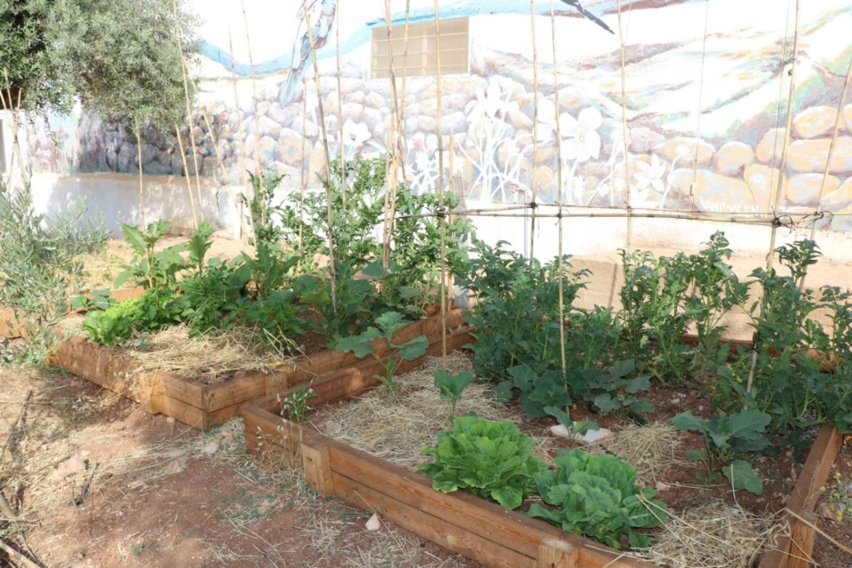



Slide 12



Slide 13

Conclusions
Academia and research will continue to suffer and quality deteriorate unless freedom is achieved
Much can be done under very difficult circumstances
Popular resistance was damaged by political structures locally and globally
People pressure such as by BDS works

Slide 14
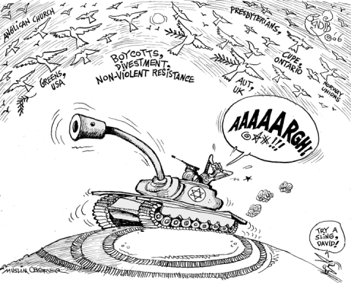
Palestinian Civil Society Call to Action 2005
Boycott
Form of pressure through non-cooperation.
Consumer actions include academic, cultural, sports, and product boycott.
Sanctions
Economic and diplomatic restrictions imposed by governments against other governments.
Divestment
The selling of stocks or bonds from a company profiting from unjust practices. This is done by institutional investors like churches and universities.
BDSmovement.net

Slide 15
Importance of Questions and self-reflection
Do I want to be a Ruhi Alkhalidi/Matiel Mughannam/Akram Zuaitar/Hanna Mikhail OR a Ragheb Nashashibi/Mahmoud Abbas?
What is “Speaking Truth to Power”: Is my role mainly raising awareness while remaining comfortable/safe or is my role engagement in the field (ala the engaged intellectual - Basil AlAraj)?
Do I evolve my activism/take time to be more innovative or keep going today as I did years ago?
Strategy for liberation? And what is my positive image for a future (not merely a reaction!)?
Flexibility versus pragmatism? Safety vs Innovation?
When do I get off the train? “You can’t be neutral on a moving train” Howard Zinn

Slide 16
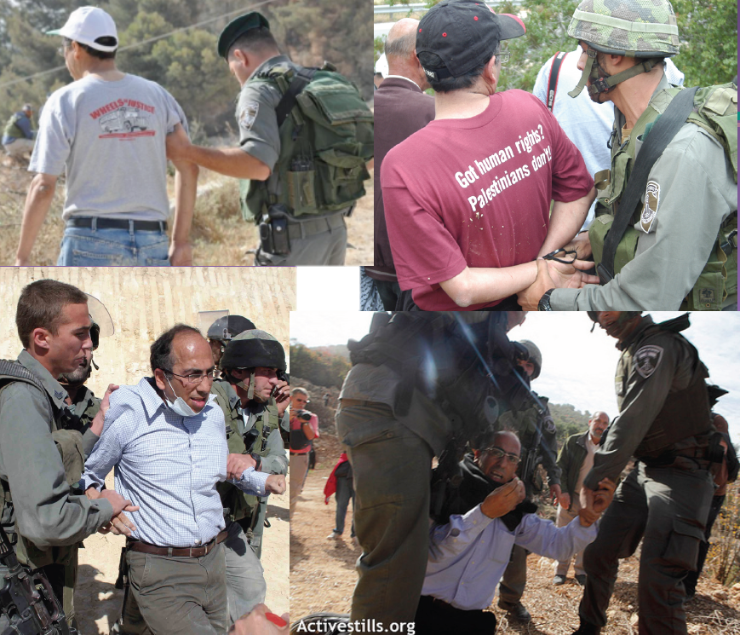

Slide 18
