Slide 1
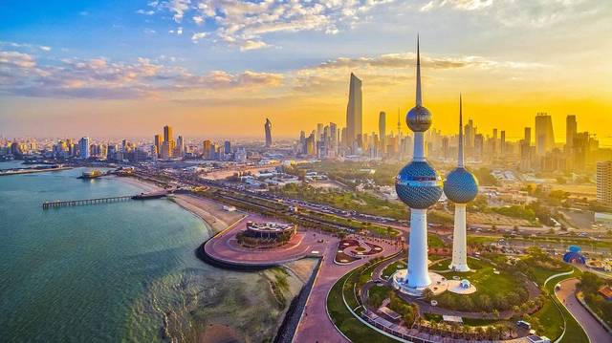
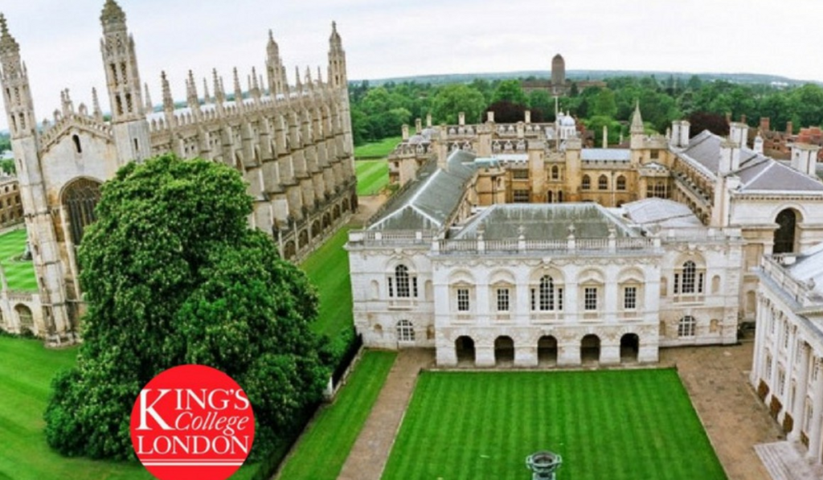





Omar S. Abu Abed, BPharm, PhD, MRSC
Assistant Professor and Scientist, Palestine
Post-doctorate Training
King’s College London, UK
2017
Born in Kuwait
Assistant Professor, Research Scientists
Palestine
2020
Assistant Professor, Research Scientists
AAUP, Palestine
BSc of Pharmacy
JUST, Jordan
Doctor of Philosophy (PhD)
Sunderland, UK
Build the bridge between the academic and industrial sector.
Launch a research academy to shape the next generation of Palestinian Scientists.

Slide 2

Dedicate, be faithful, have novel goals& intention.
Trust your abilities, don’t wait for the opportunity.
Never ask one to plan on your behalf.
Grab the first acceptable opportunity even if it is humble, you don’t have to reach the moon from the first attempt.
Knowledge and rested body never intersect.
Diligence does not contradict relaxation and enjoying what you do.
Only consult whom you trust that they love you and have wisdom.
Helpful pieces of advice
Omar S. Abu Abed, BPharm, PhD, MRSC
Assistant Professor and Scientist, Palestine

Slide 3
In BSc, study hard but right.
Have model examples, never copy them.
Always go in two parallel ways.
Don’t count years.
Spare some time for your hobbies.
Be a human not a robot.
Do not jump to the next level before finishing the earlier one.
I wish I had known
Omar S. Abu Abed, BPharm, PhD, MRSC
Assistant Professor and Scientist, Palestine

