Slide 1
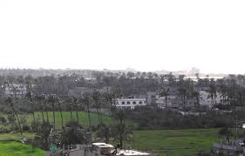
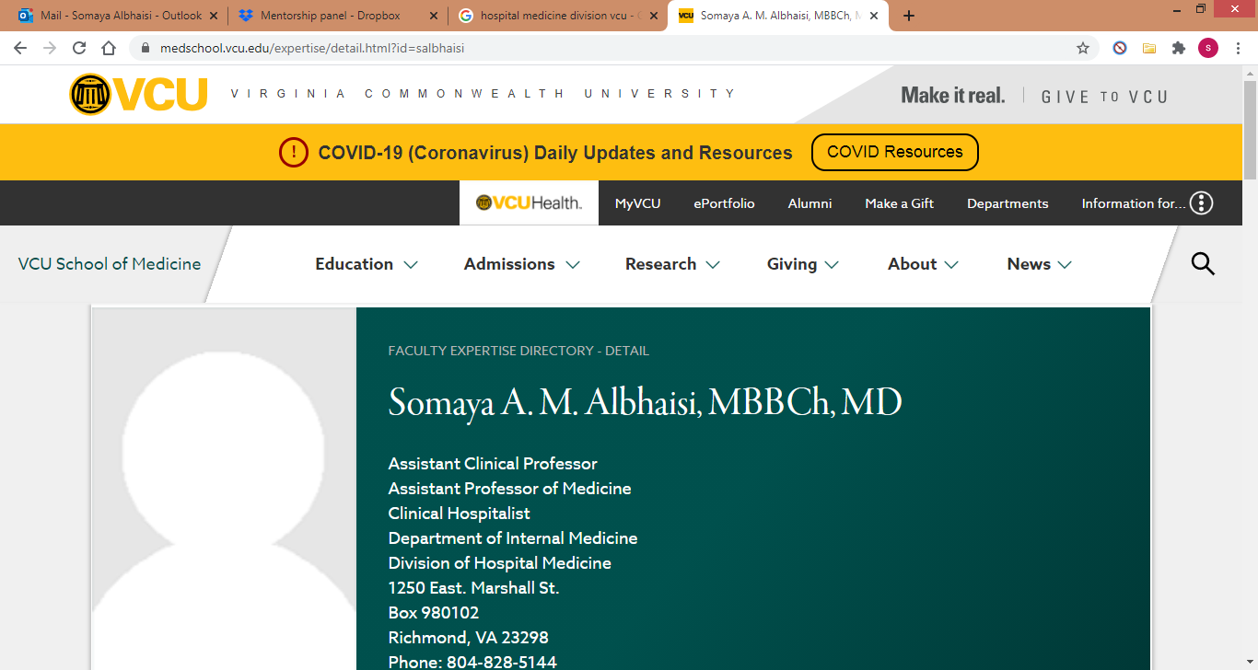
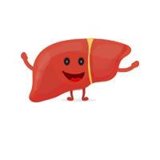
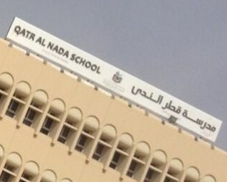
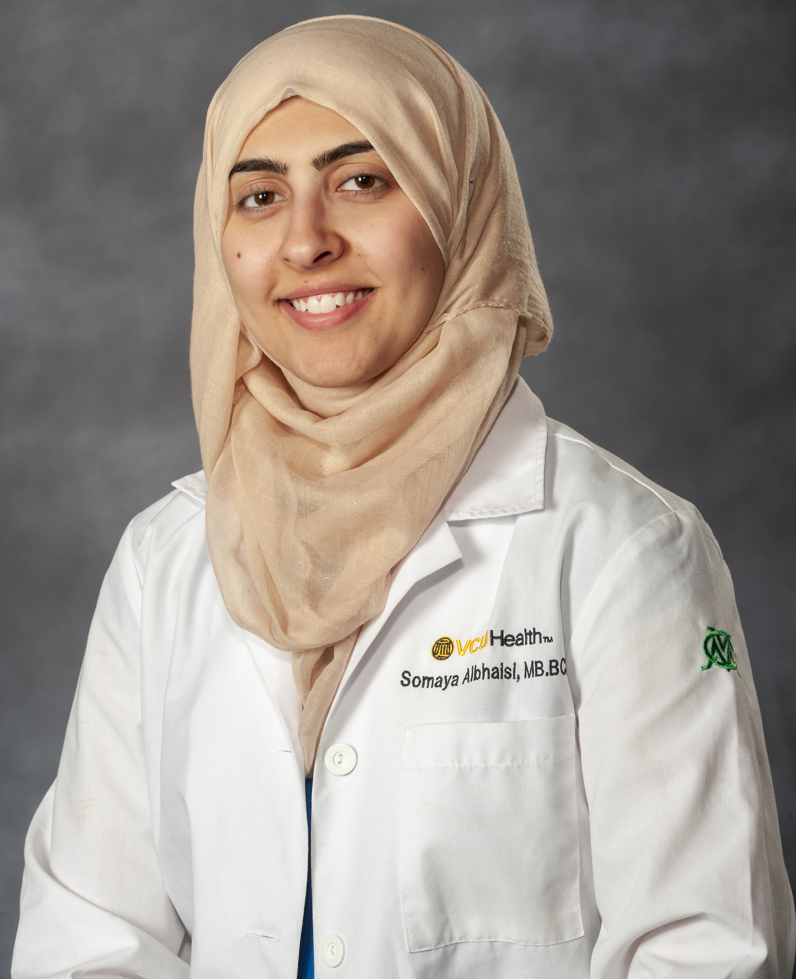
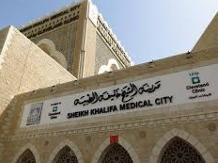
Somaya Albhaisi, MBBCh, MD
Assistant Professor of Medicine, Virginia Commonwealth University, Richmond, VA, USA
Born in Deir AlBalah
Gaza Strip, Palestine
Assistant Professor, Hospitalist, Physician-Scientist
Virginia, USA
Internal Medicine Residency
Virginia, USA
High School
Abu Dhabi, UAE
Graduated 2019
Graduated 2008
Med School (MBBCh)
Dubai, UAE
Internal Medicine Residency
Abu Dhabi, UAE
Traditional GI/Hepatology Fellowship?
Research Track Fellowship?
Continue as faculty and build a research career?
Graduated 2014
Until 2016
somaya_90@hotmail.com

Slide 2
Somaya Albhaisi, MBBCh, MD
Assistant Professor of Medicine, Virginia Commonwealth University, Richmond, VA, USA
Helpful advice I received:
Have a mentor
In research….Focus on one thing
Hard work with Passion works
Dream big, but remember that dreams without goals are just dreams
If you don’t fail, you’re not even trying
You must have a purpose for your life
Things I wish I had known or done earlier:
Get involved in research early and do as much as possible
Mentorship
Take the USMLEs earlier
Post-doc fellowships
Doing electives in the US
More extracurricular activities and volunteer work

