Slide 1
Palestine Electricity and Renewable Energy Policy Model: History, current status, Challenges and what should be next
Tamer KHATIB
Associate Professor of Renewable energy

Slide 2
Energy Poverty in Palestine
Pinhas Rotenberg power house
Electricity for Arab and Jew
The conflict
Jaffa vs Tal-Aivi
Source: Electrification of Palestine, Ronin Shamer. Oxford. 2016

Slide 3
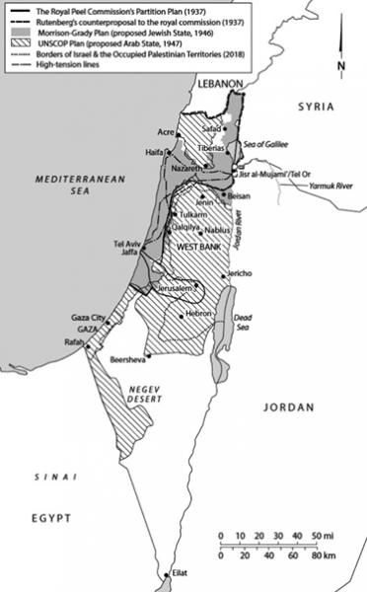
Electrification of Palestine: The History
Local efforts
Jordan Electricity Distribution Company
Source: Electrical Palestine: Capital and Technology from Empire to Nation (Oakland: University of California Press, 2019), 212

Slide 4
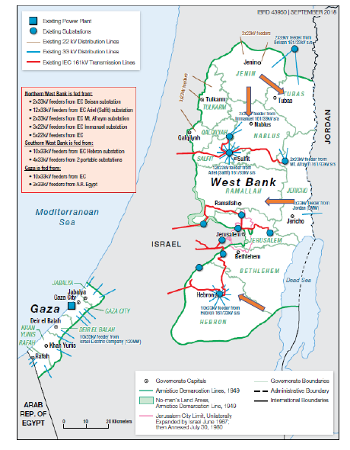
After Jordan, 1987: the connection to IEC
IEC 161 kV connection
JEDCO connections
Source: PENRA report: Resettlement-Framework-Advancing-Sustainability-in-Performance-Infrastructure-and-Reliability-of-the-Energy-Sector-in-the-West-Bank-and-Gaza-P170928, 2020

Slide 5
OSLO accords and Energy
Electricity Collaboration
Energy Collaboration
Source: Tamer Khatib, Palestine RE energy policy model: Current status and should be next ?, 2021. Sustainable Technologies and Assessment: Paper is under review

Slide 6
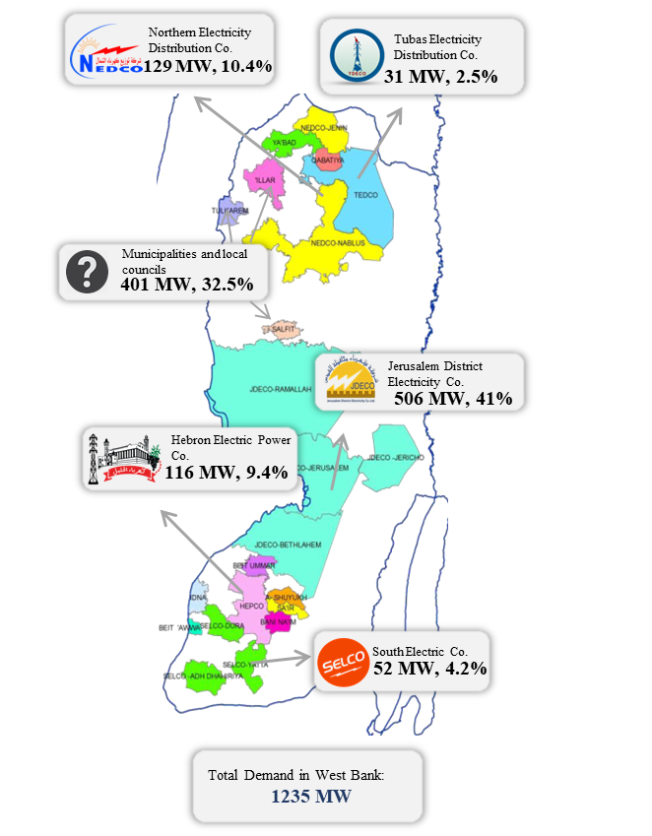
Current Energy Frame work
Source: Tamer Khatib, Palestine RE energy policy model: Current status and should be next ?, 2021. Sustainable Technologies and Assessment: Paper is under review

Slide 7
Current Energy Frame work
Source: Tamer Khatib, Palestine RE energy policy model: Current status and should be next ?, 2021. Sustainable Technologies and Assessment: Paper is under review

Slide 8
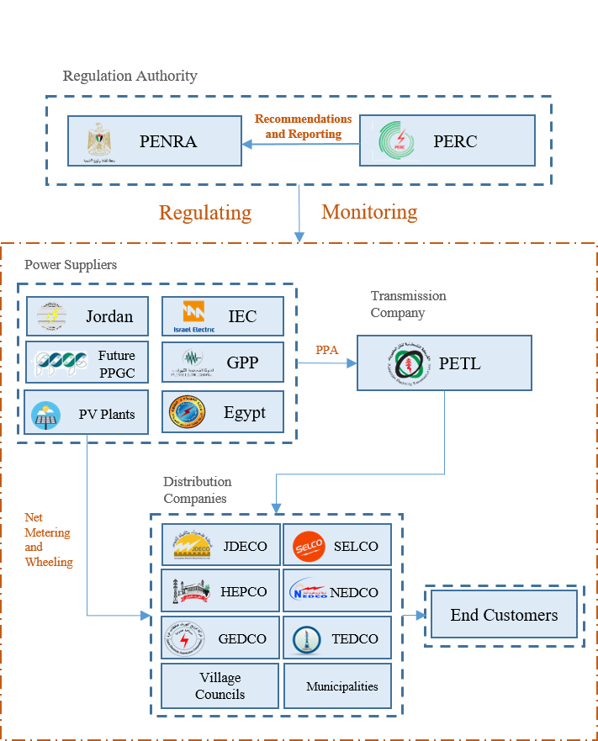
PETL & PA Desired Energy Frame work
Source: Tamer Khatib, Palestine RE energy policy model: Current status and should be next ?, 2021. Sustainable Technologies and Assessment: Paper is under review

Slide 9
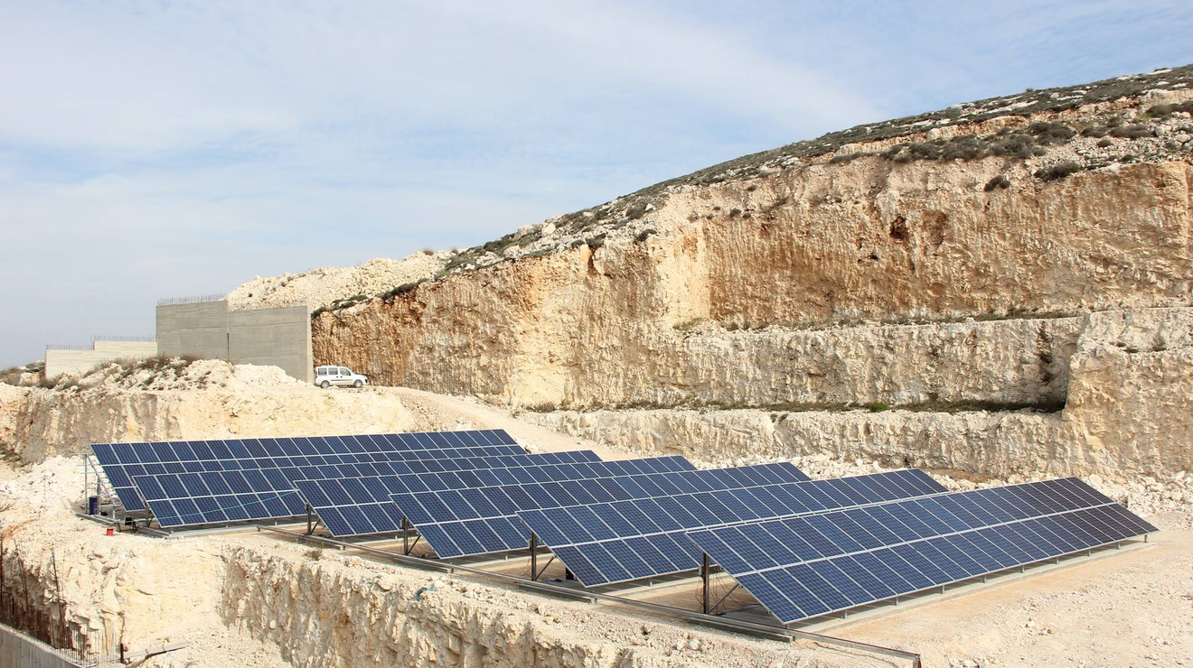
Renewable Energy for Dependency: The dream
Source: Tamer Khatib, Palestine RE energy policy model: Current status and should be next ?, 2021. Sustainable Technologies and Assessment: Paper is under review

Slide 10
The absence of RE policy model in Palestine
Source: Tamer Khatib, Palestine RE energy policy model: Current status and should be next ?, 2021. Sustainable Technologies and Assessment: Paper is under review

Slide 11
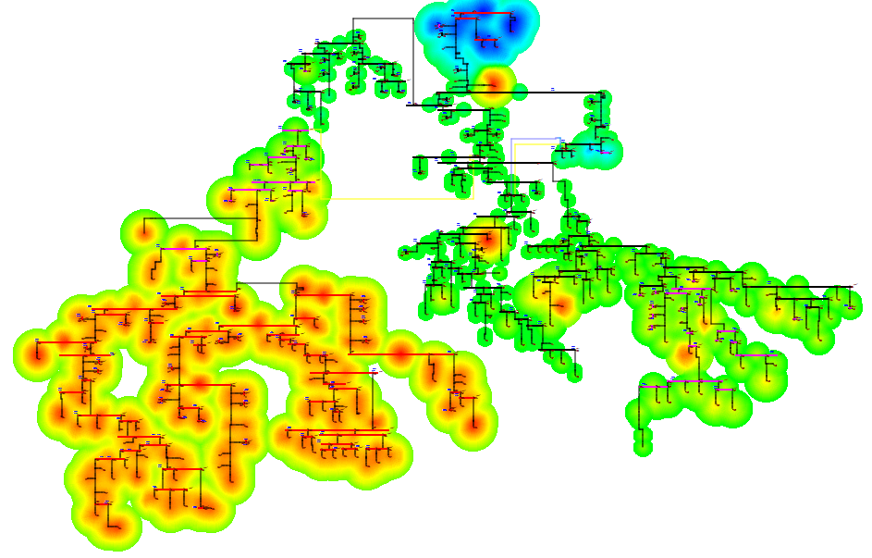
The absence of RE policy model in Palestine
Source: Tamer Khatib, Palestine RE energy policy model: Current status and should be next ?, 2021. Sustainable Technologies and Assessment: Paper is under review

Slide 12
What should be next
Addressing current barriers
Reforming of Palestine Renewable energy policy model
Unbundling of Transmission lines
Power transmission lines privatization
Source: Tamer Khatib, Palestine RE energy policy model: Current status and should be next ?, 2021. Sustainable Technologies and Assessment: Paper is under review

Slide 13
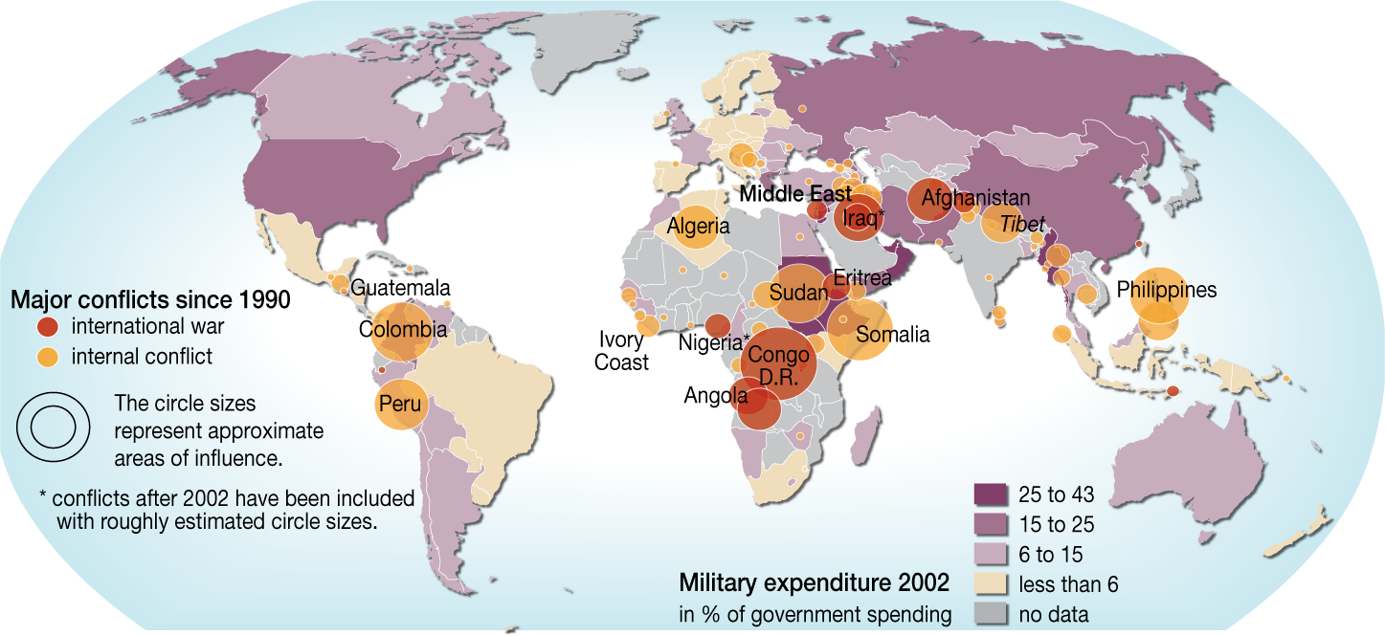
Energy for Peace

Slide 14
Thank you

